Slide 1
User Modeling

Slide 2
You are what you post!
Represent users by documents
a user = a document including all she said

Slide 3
You are what you post!
Modeling User Personality (Computational Social Science)
Personality traits in psychology
Big Five: extraversion, emotional stability, agreeableness, conscientiousness, and openness to experience
Modeling User Health Profile (Computational Epidemiology)
Privacy of the user, Ethical principles
Modeling Gender and Ethnicity
First names → gender; Last names → ethnicity
Modeling User Location

Slide 4
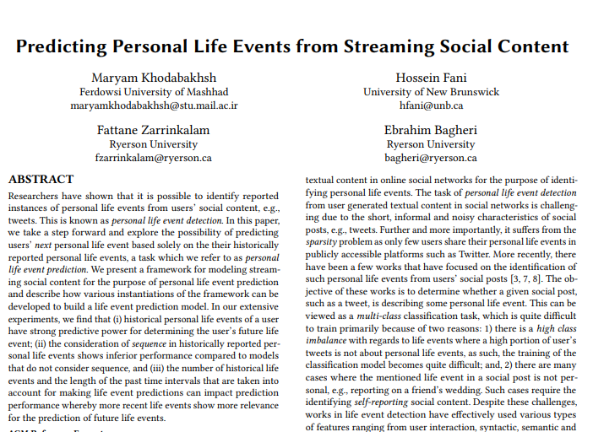
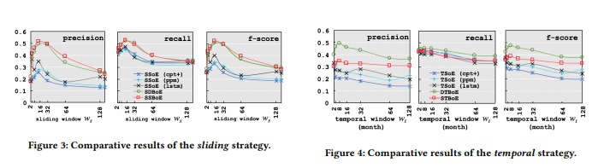
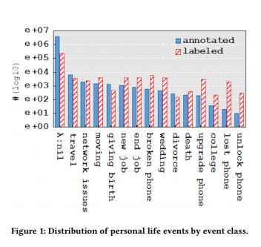
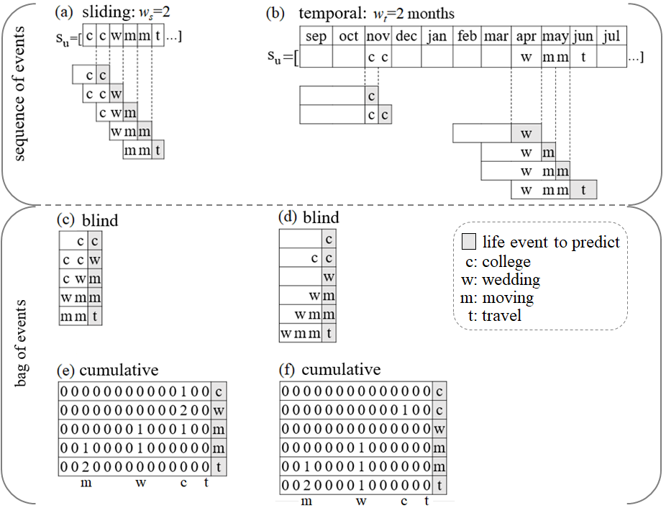
You are what you post! within time.

Slide 5
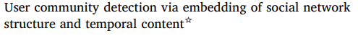
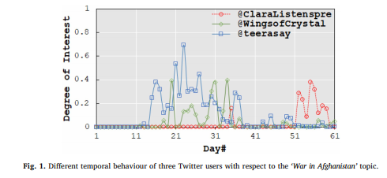
You are what you post! within time.
All users are interested in z₄₄=‘War in Afghanistan’

Slide 6
You are what you post! within time.
All users are interested in z₄₄=‘War in Afghanistan’
but not aligned in time!

Slide 7
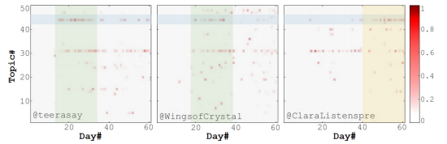
You are what you post! within time.
All users are interested in z₄₄=‘War in Afghanistan’
but not aligned in time!

Slide 8
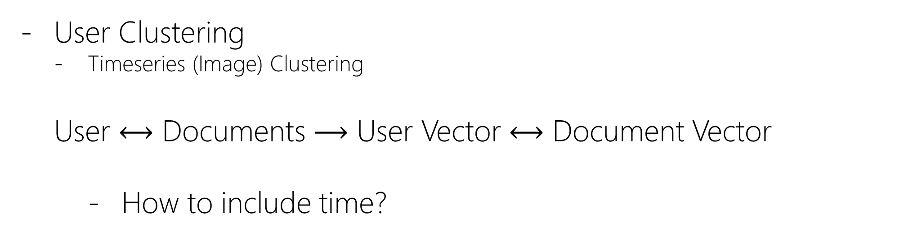
Diachronically Like-minded User Community Detection
User Clustering
Timeseries (Image) Clustering
User $⟷$ Documents $⟶$ User Vector $⟷$ Document Vector
How to include time?

Slide 9
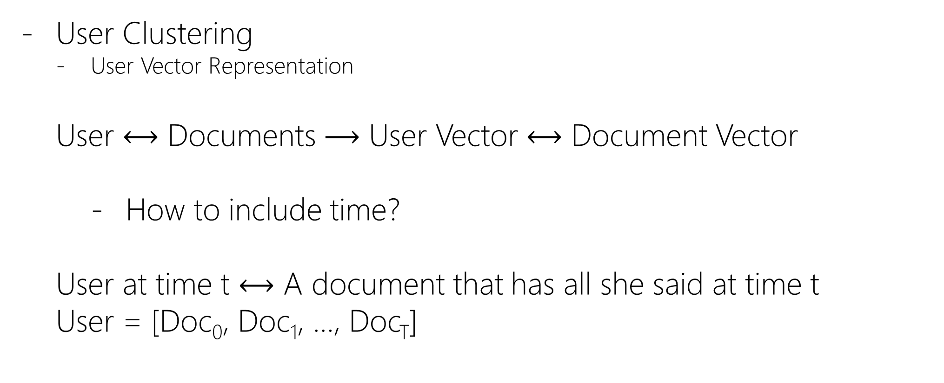
Diachronically Like-minded User Community Detection
User Clustering
User Vector Representation
User $⟷$ Documents $⟶$ User Vector $⟷$ Document Vector
How to include time?
User at time t $⟷$ A document that has all she said at time t
User = [Doc₀, Doc₁, …, Doc_{T}]

Slide 10
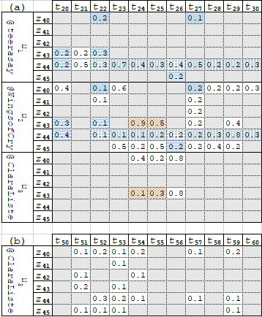

Diachronically Like-minded User Community Detection
User = [Doc₀, Doc₁, …, Doc_{T}]
LDA
User = [[z ⁽⁰⁾_{1:K}], [z ⁽¹⁾_{1:K}], …, [z^{(T)}_{1:K}]]

Slide 11
Diachronically Like-minded User Community Detection
User = [Doc₀, Doc₁, …, Doc_{T}]
LDA
User = [[z ⁽⁰⁾_{1:K}], [z ⁽¹⁾_{1:K}], …, [z^{(T)}_{1:K}]]
Two users are similar if they share more cells!
each cell = 1×1×1 cube ={u_{i}}×{z_{j}}×{t_{k}}
Shared cell = n×m×k cube
e.g., {u₁u₂}×{z₄₄}×{t₂₂ t₂₃ … t₃₀}

Slide 12
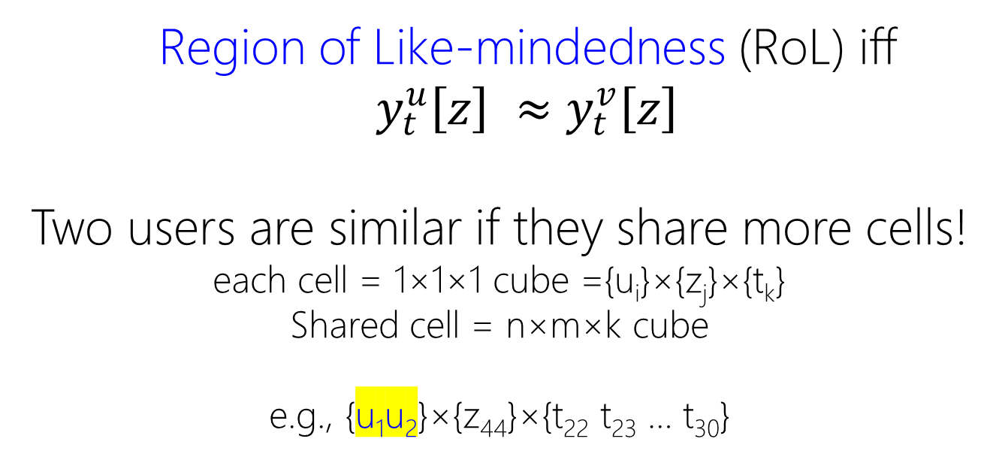
Diachronically Like-minded User Community Detection
Region of Like-mindedness (RoL) iff $y_{t}^{u}\left[z\right] ≈y_{t}^{v}\left[z\right]$
Two users are similar if they share more cells!
each cell = 1×1×1 cube ={u_{i}}×{z_{j}}×{t_{k}}
Shared cell = n×m×k cube
e.g., {u₁u₂}×{z₄₄}×{t₂₂ t₂₃ … t₃₀}

Slide 13
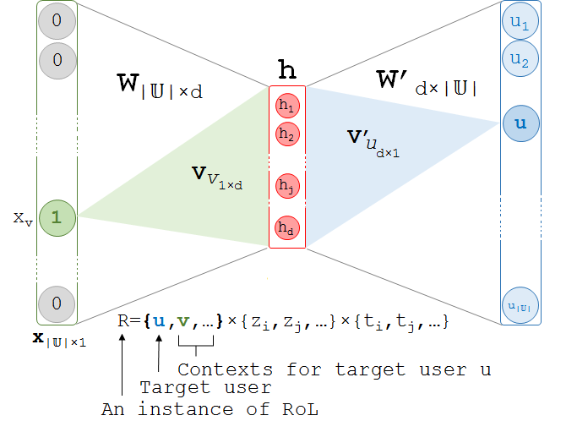
Diachronically Like-minded User Community Detection
User Clustering
Timeseries (Image) Clustering
User2Vec: User Vector Representation: Two Similar Users → Similar Vectors

Slide 14

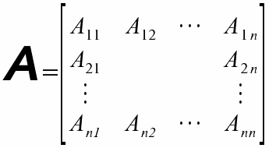
Louvain Method (Blondel et al. JSTAT 2008)
Diachronically Like-minded User Community Detection

Slide 15
Evaluation: how accurate are the communities?
Diachronically Like-minded User Community Detection
Are these users are sharing:
Same topics
In the same time intervals

Slide 16
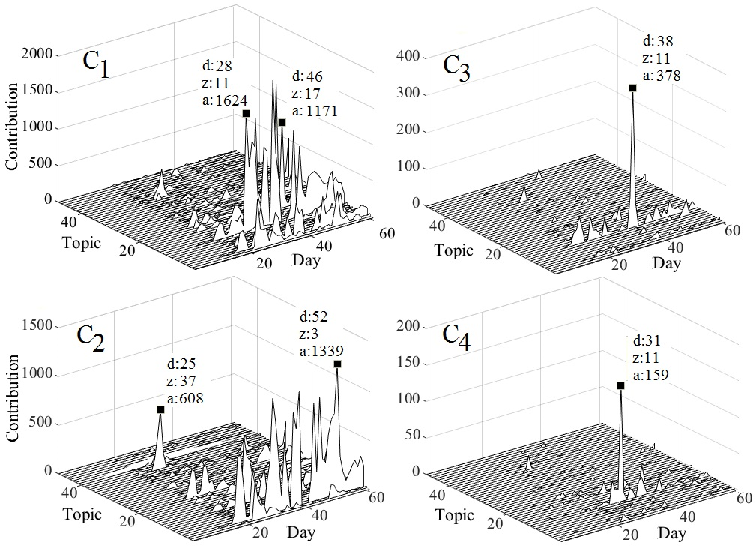
Evaluation: how accurate are the communities?
Diachronically Like-minded User Community Detection
Are these users are sharing:
Same topics
In the same time intervals
Qualitative:

Slide 17
Evaluation: how accurate are the communities?
Diachronically Like-minded User Community Detection
Are these users are sharing:
Same topics
In the same time intervals
Quantitative:
Intrinsic: golden communities

Slide 18
Evaluation: how accurate are the communities?
Diachronically Like-minded User Community Detection
Are these users are sharing:
Same topics
In the same time intervals
Quantitative:
Intrinsic: golden communities
Extrinsic: help another applications
News Recommendation
Recommend news articles to users to read at today, tomorrow, next week.
Instead of per user recommendation, we recommend to the communities!

Slide 19
Evaluation: how accurate are the communities?
Diachronically Like-minded User Community Detection
Recommend news articles to users to read at today, tomorrow, next week.
Instead of per user recommendation, we recommend to the communities!

Slide 20
Evaluation: how accurate are the communities?
Diachronically Like-minded User Community Detection
all three users in same community
Recommend news articles about
- Z₄₄ : “War in Afghanistan”
- at day = 40

Slide 21
Evaluation: how accurate are the communities?
Diachronically Like-minded User Community Detection
the first two users in same community
the last user in another community
Recommend news articles about
- Z₄₄ : “War in Afghanistan”
- at day = 40

Slide 22
Evaluation: how accurate are the communities?
Diachronically Like-minded User Community Detection
all three users in same community
Recommend news articles about
- Z₄₄ : “War in Afghanistan”
- at day = 60

Slide 23
Evaluation: how accurate are the communities?
Diachronically Like-minded User Community Detection
the first two users in same community
the last user in another community
Recommend news articles about
- Z₄₄ : “War in Afghanistan”
- at day = 60

Slide 24

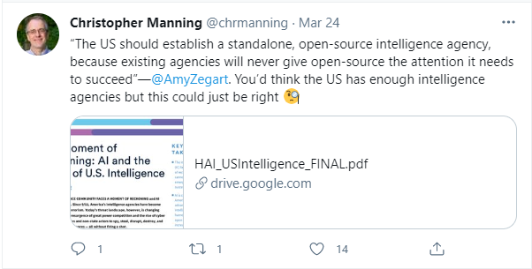
Evaluation Strategy
Diachronically Like-minded User Community Detection
Assumption:
users are interested in the topics of the news article about which they have posted

Slide 25
Evaluation Strategy
Diachronically Like-minded User Community Detection
Golden Dataset Curation:
news articles to which a user has explicitly linked in her tweets
mentions = {(user, news article, timestamp)}

Slide 26
Evaluation Strategy
Diachronically Like-minded User Community Detection
News Recommendation:
mentions = {(user, ?, timestamp)}
We recommend news article n
About topic z
At timestamp t
To a community that shows overall burst at time t about z

Slide 27
Evaluation Strategy
Diachronically Like-minded User Community Detection
News Recommendation:
mentions = {(user, ?, timestamp)}
We hope the community
Read news article n
Tweet news article n

Slide 28
Evaluation Strategy
Diachronically Like-minded User Community Detection
News Recommendation:
mentions = {(user, ?, timestamp)}
We evaluate
Our hope: (user, n , timestamp)}
The reality: (user, news article, timestamp)

Slide 29
Evaluation Strategy
Diachronically Like-minded User Community Detection
Dataset:
Abel et al.: Twitter,
3M tweets
Posted by 135K users
Between Nov. 1 and Dec. 31, 2010.
Golden Entries:
- 25,756 triples extracted from 3,468 distinct news articles posted by 1,922 users

Slide 30
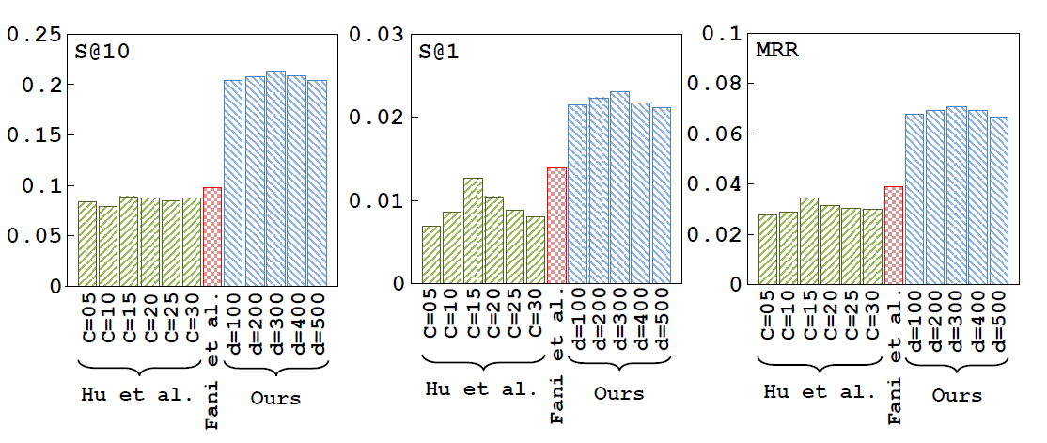
Evaluation Strategy
Diachronically Like-minded User Community Detection

Slide 31
Evaluation Strategy (Second)
Diachronically Like-minded User Community Detection
User Prediction:
Seen a stray tweet, who is the author?
Probably from community C because this community talked a lot about the topics of the mentioned news article n at timestamp t
mentions = {(?, news article, timestamp)}

Slide 32
Evaluation: how accurate are the communities?
Diachronically Like-minded User Community Detection
the first two users in same community
the last user in another community
Stray tweet about
- Z₄₄ : “War in Afghanistan”
- at day = 40

Slide 33
Evaluation: how accurate are the communities?
Diachronically Like-minded User Community Detection
the first two users in same community
the last user in another community
Stray tweet about
- Z₄₄ : “War in Afghanistan”
- at day = 60

Slide 34
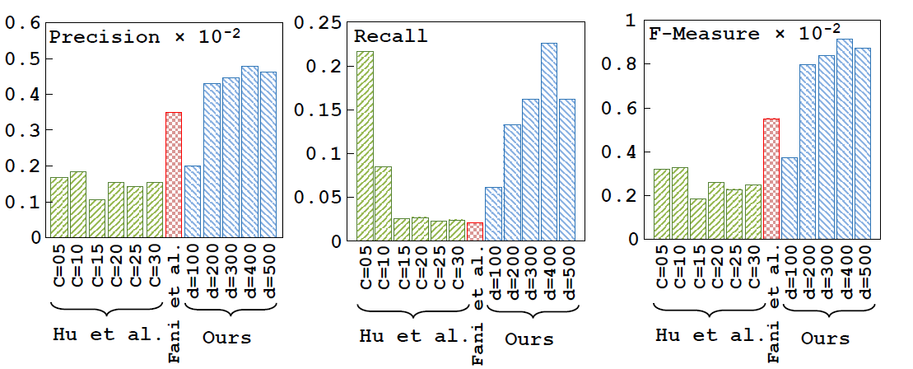
Evaluation Strategy (Second)
Diachronically Like-minded User Community Detection
User Prediction:

Slide 35
Evaluation Strategy (Second)
Diachronically Like-minded User Community Detection
User Prediction:

Slide 36
User Community Prediction
User Community Detection in Future!

Slide 37
User Community Prediction

